Slide 1
AP3082 Presentation:
XY-Model
Kah Jen Wo and Juan Torres

Slide 2
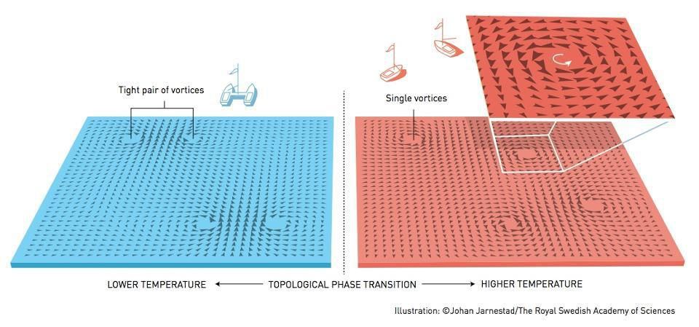
The XY model
Research questions
What is the order parameter that describes the system?
What is the behaviour of the system under different algorithms?

Slide 3
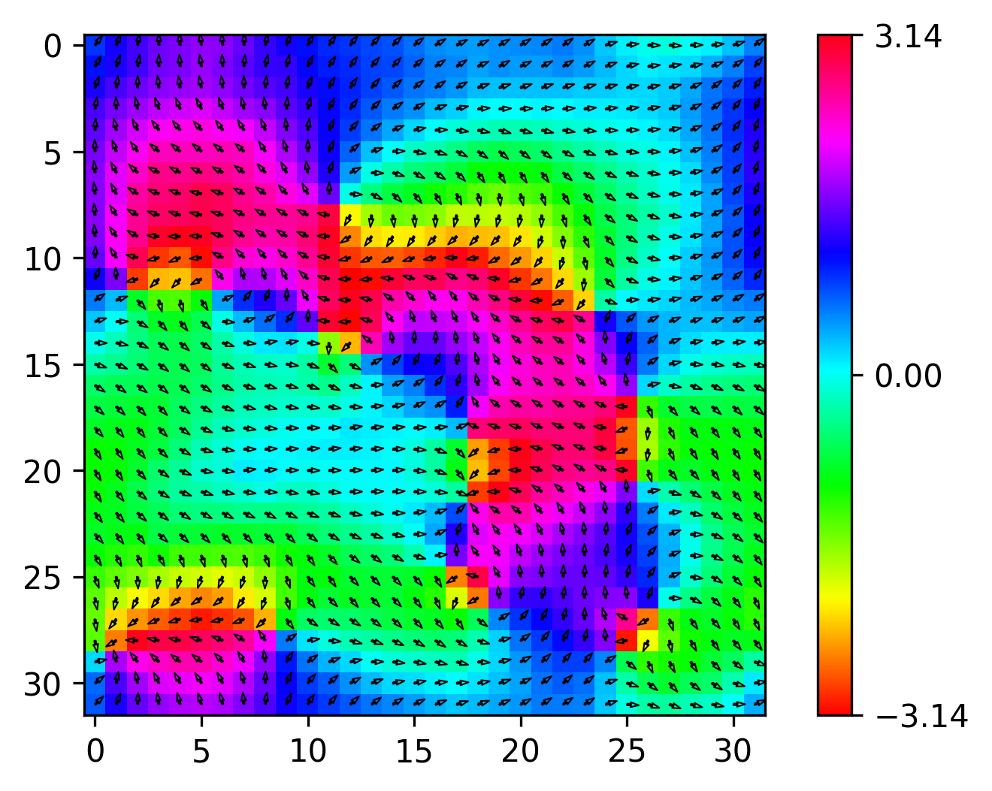
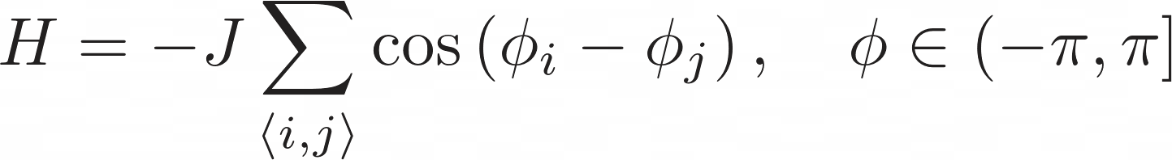
The XY model
Two-dimensional.
Ferromagnetic, J > 0.
Nearest-neighbour model.
Periodic boundary condition.
Notes:
The XY-Model can be used to describe any system with one degree of freedom, which in this case is the angle of the spins that they make with respect to the x-axis, where the angles range from -pi to pi. This means that the spins throughout the lattice varies continuously. This is in contrast to the Ising model, where the spins are limited to only spin up or down.
Its Hamiltonian/energy is given by the cosine of the differences in the angles of the spins make with respect to each other.
In our case, we will be studying the 2D square lattice ferromagnetic XY-Model ( J, must be larger than 0), with the nearest-neighbour approximation.
Otherwise, the system would be anti-ferromagnetic, which we will not talk about in this presentation.

Slide 4
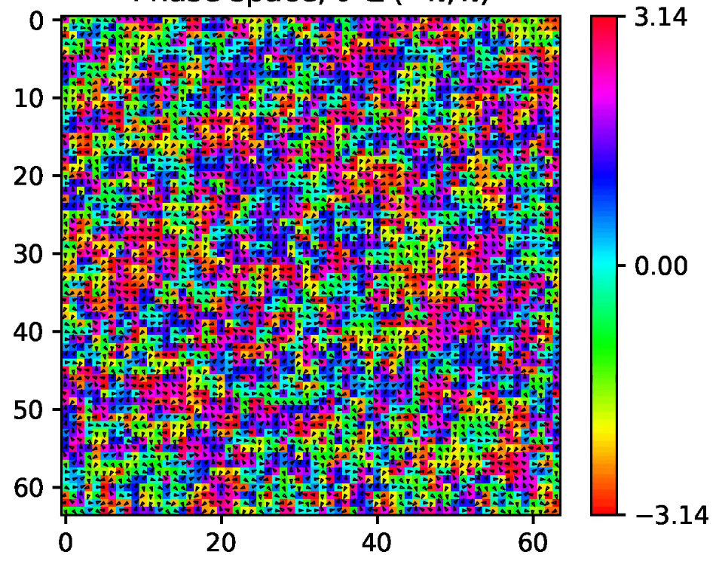
Temperature phases?
Low temperature
High temperature
Notes:
The XY-Model can be used to describe any system with one degree of freedom, which in this case is the angle of the spins that they make with respect to the x-axis, where the angles range from -pi to pi. This means that the spins throughout the lattice varies continuously. This is in contrast to the Ising model, where the spins are limited to only spin up or down.
Its Hamiltonian/energy is given by the cosine of the differences in the angles of the spins make with respect to each other.
In our case, we will be studying the 2D square lattice ferromagnetic XY-Model ( J, must be larger than 0), with the nearest-neighbour approximation.
Otherwise, the system would be anti-ferromagnetic, which we will not talk about in this presentation.

Slide 5
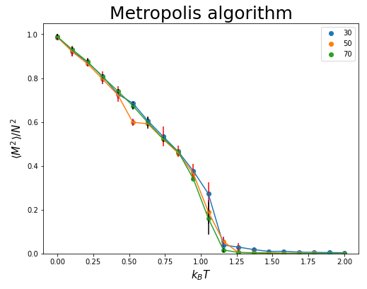
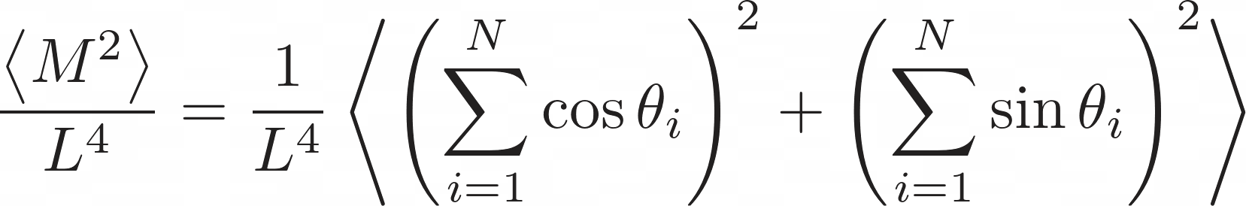
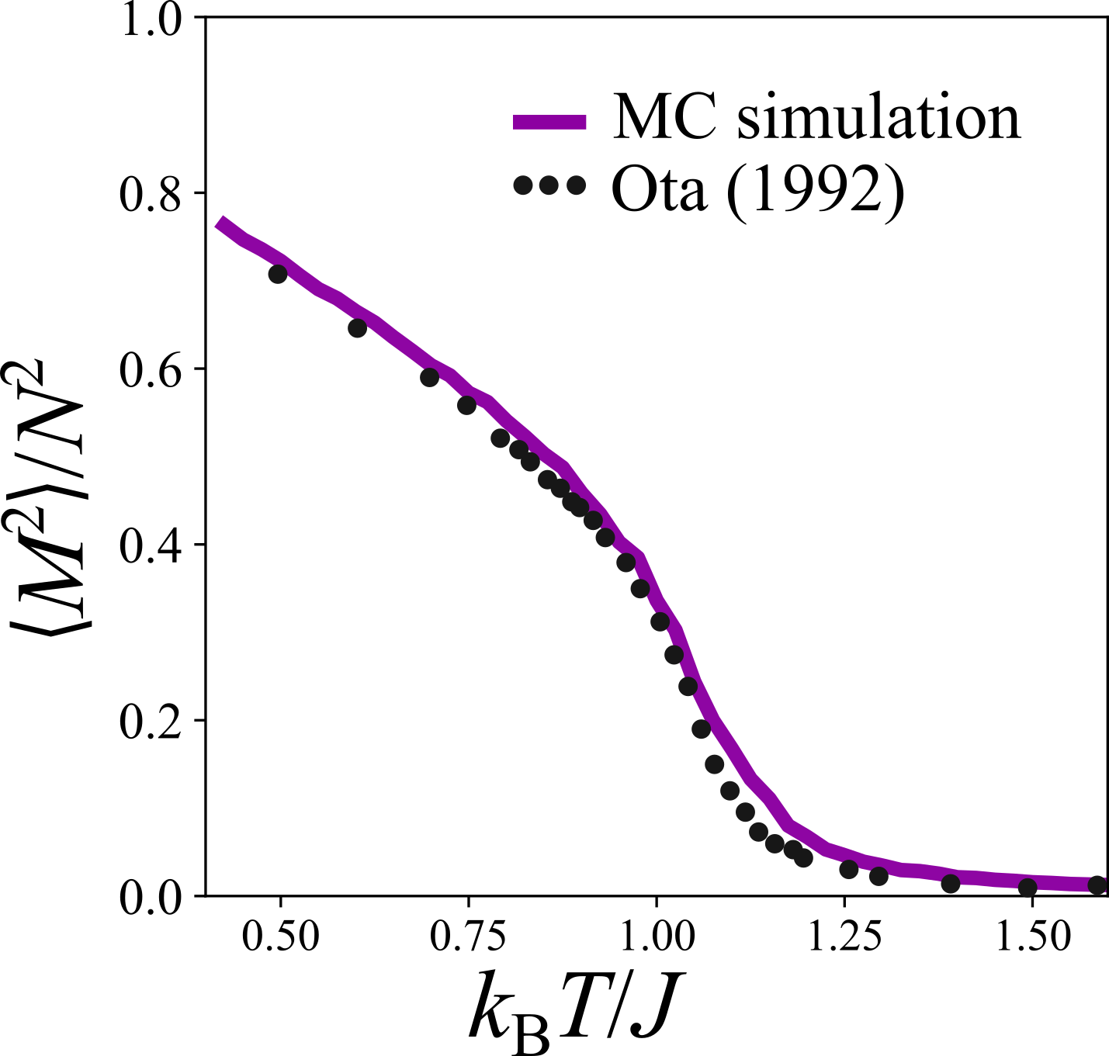
Magnetization vs Temperature
Smooth transition from low to high temperature.
Absence of long-range order.
Consistent behaviour under different algorithms.
Notes:
The XY-Model can be used to describe any system with one degree of freedom, which in this case is the angle of the spins that they make with respect to the x-axis, where the angles range from -pi to pi. This means that the spins throughout the lattice varies continuously. This is in contrast to the Ising model, where the spins are limited to only spin up or down.
Its Hamiltonian/energy is given by the cosine of the differences in the angles of the spins make with respect to each other.
In our case, we will be studying the 2D square lattice ferromagnetic XY-Model ( J, must be larger than 0), with the nearest-neighbour approximation.
Otherwise, the system would be anti-ferromagnetic, which we will not talk about in this presentation.

Slide 6
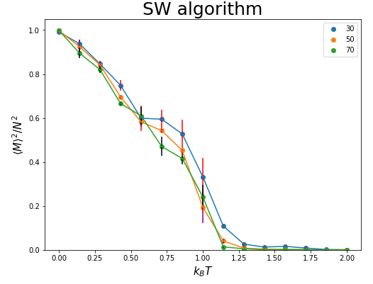
Magnetization vs Temperature
Smooth transition from low to high temperature.
Absence of long-range order.
Consistent behaviour under different algorithms.
Is there a phase transition?
Notes:
The XY-Model can be used to describe any system with one degree of freedom, which in this case is the angle of the spins that they make with respect to the x-axis, where the angles range from -pi to pi. This means that the spins throughout the lattice varies continuously. This is in contrast to the Ising model, where the spins are limited to only spin up or down.
Its Hamiltonian/energy is given by the cosine of the differences in the angles of the spins make with respect to each other.
In our case, we will be studying the 2D square lattice ferromagnetic XY-Model ( J, must be larger than 0), with the nearest-neighbour approximation.
Otherwise, the system would be anti-ferromagnetic, which we will not talk about in this presentation.

Slide 7
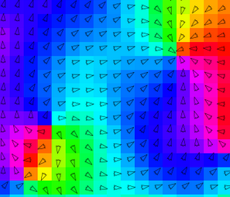
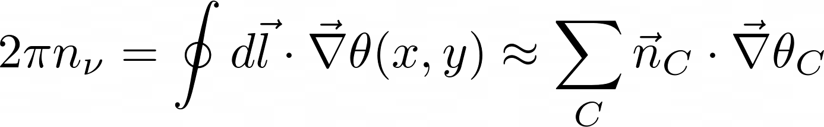
Vortices and anti-vortices
They are sources (sinks) of winding spins.
Vorticity is a path integral around a vortex.
Notes:
However, recall that the XY model has continuous symmetry, and that such a symmetry does not break spontaneously in 2D at finite temperature. And it turns out that magnetisation, unlike in Ising model, is actually not a good order parameter to characterise the transition. (We will show this with simulation results later).
It also turns out that Kosterlitz and Thouless have shown that the phase transition in the XY model is driven by the binding and unbinding of vortex - anti-vortex pairs. So what are these vortices and anti vortices?
In the figure here, we have a vortex. The solid circle represents a spin and if the spin does a full clockwise turn, it is said to have a vorticity of +1.
In this other figure, we have the anti-vortex, where the spin does a full anti-clockwise turn, and it is said that it has a vorticity of -1.
Note that these vorticity is always of integer value. Keep this in mind because this is important.
They can be thought of as quasi-particles and Kosterlitz and Thouless showed how the emergence them led to superconductivity in thin materials. Therefore, it is of interest to study the 2D XY model.

Slide 8
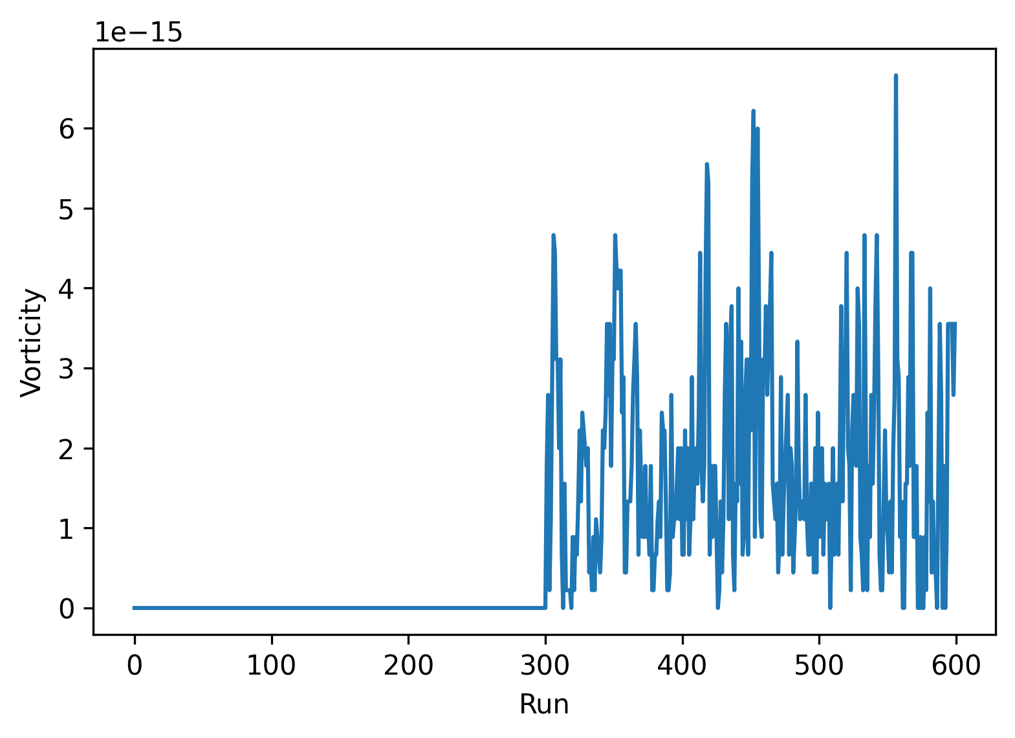
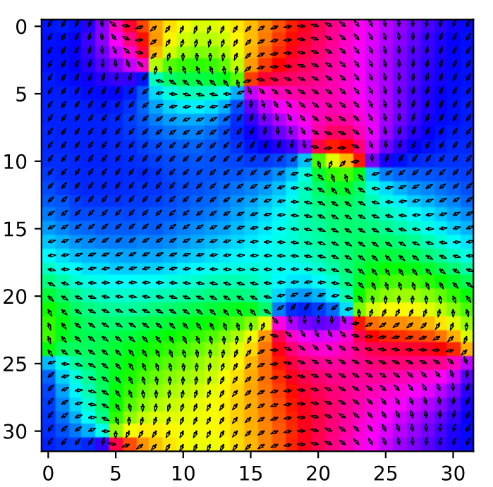
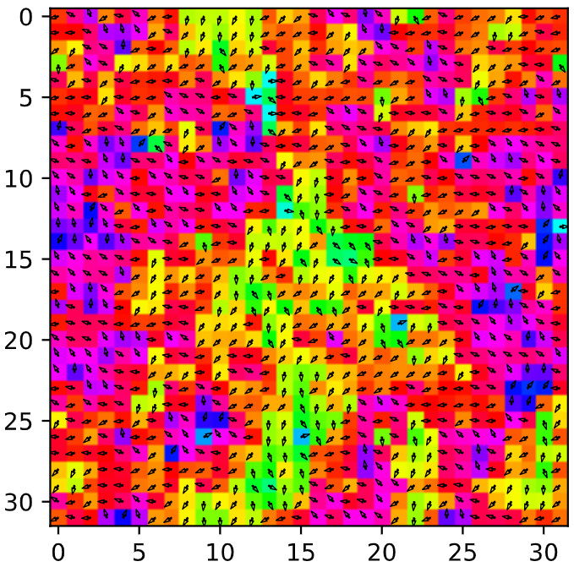
Vortices and anti-vortices
T=3T_{c}
Low temperature phase: Pairs of vortices
High temperature phase: Unbinded vortices
Vorticity can be used as an order parameter in the XY model.
T=0.0T_{c}
L=32, τ_{relax} = 500000, τ_{extra} = 2000
Notes:
However, recall that the XY model has continuous symmetry, and that such a symmetry does not break spontaneously in 2D at finite temperature. And it turns out that magnetisation, unlike in Ising model, is actually not a good order parameter to characterise the transition. (We will show this with simulation results later).
It also turns out that Kosterlitz and Thouless have shown that the phase transition in the XY model is driven by the binding and unbinding of vortex - anti-vortex pairs. So what are these vortices and anti vortices?
In the figure here, we have a vortex. The solid circle represents a spin and if the spin does a full clockwise turn, it is said to have a vorticity of +1.
In this other figure, we have the anti-vortex, where the spin does a full anti-clockwise turn, and it is said that it has a vorticity of -1.
Note that these vorticity is always of integer value. Keep this in mind because this is important.
They can be thought of as quasi-particles and Kosterlitz and Thouless showed how the emergence them led to superconductivity in thin materials. Therefore, it is of interest to study the 2D XY model.

Slide 9
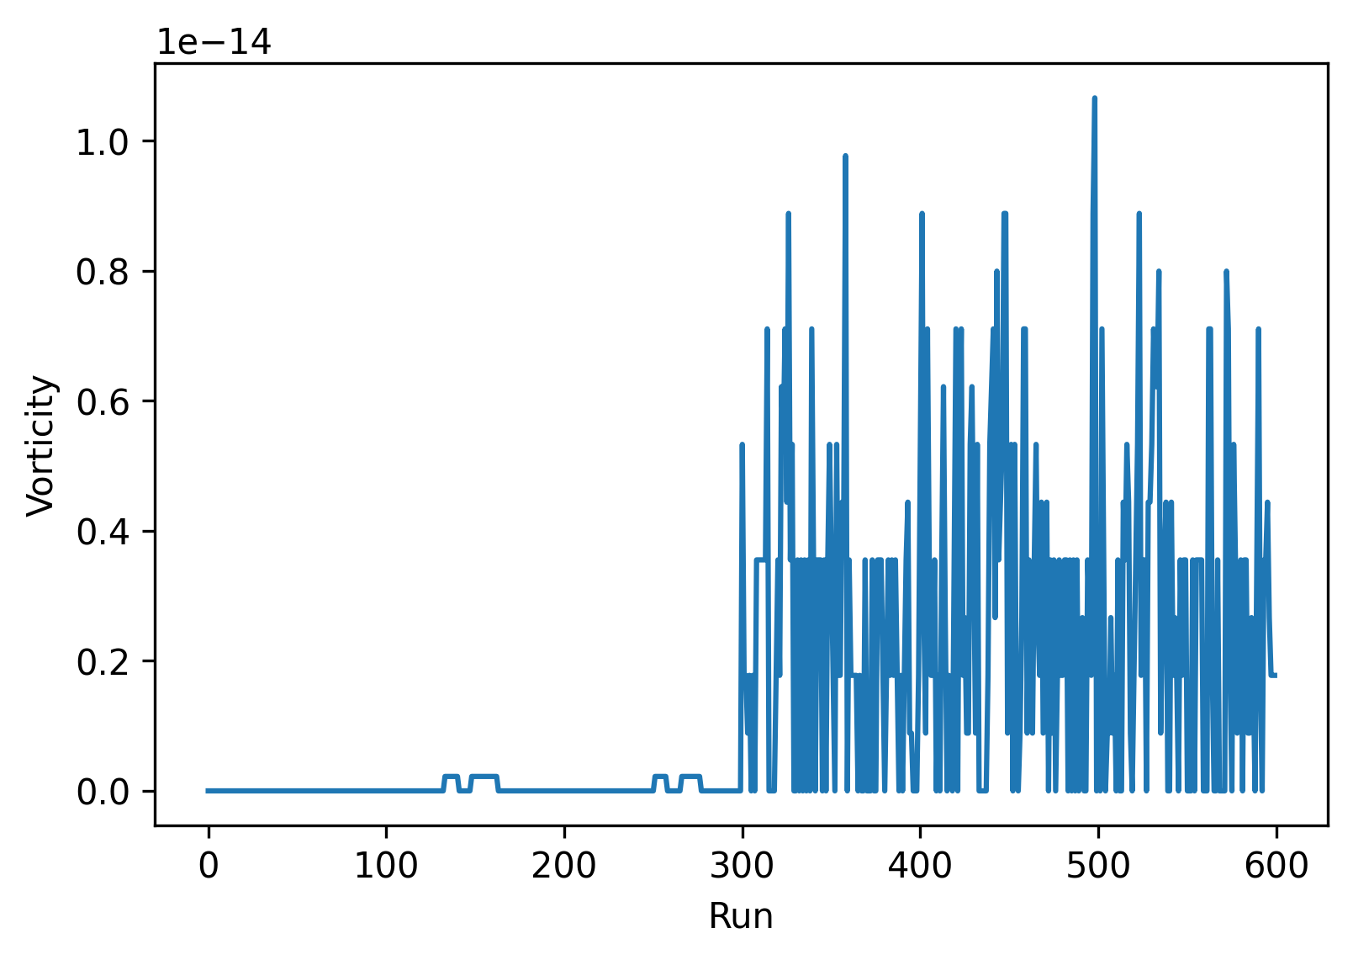
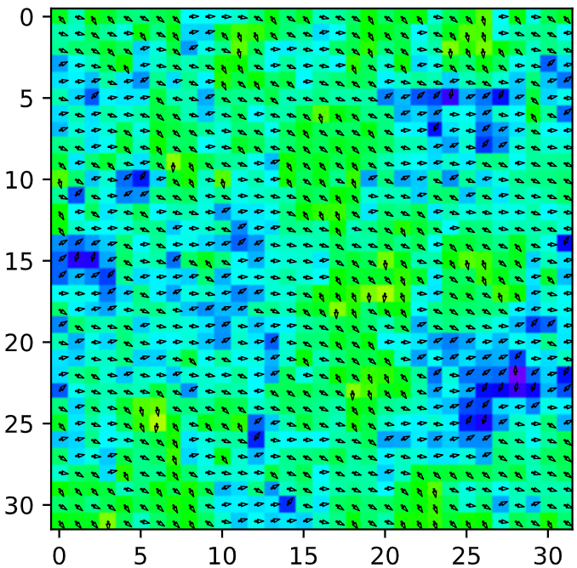
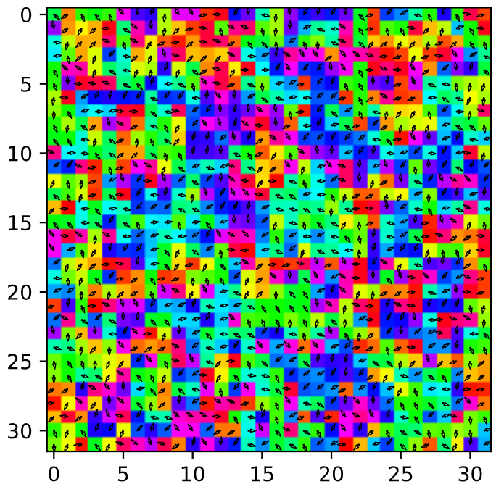
Vortices and anti-vortices
T=2T_{c}
Low temperature phase: Pairs of vortices
High temperature phase: Unbinded vortices
Vorticity can be used as an order parameter in the XY model?
T=0.5T_{c}
L=32, τ_{relax} = 500000, τ_{extra} = 2000
Notes:
However, recall that the XY model has continuous symmetry, and that such a symmetry does not break spontaneously in 2D at finite temperature. And it turns out that magnetisation, unlike in Ising model, is actually not a good order parameter to characterise the transition. (We will show this with simulation results later).
It also turns out that Kosterlitz and Thouless have shown that the phase transition in the XY model is driven by the binding and unbinding of vortex - anti-vortex pairs. So what are these vortices and anti vortices?
In the figure here, we have a vortex. The solid circle represents a spin and if the spin does a full clockwise turn, it is said to have a vorticity of +1.
In this other figure, we have the anti-vortex, where the spin does a full anti-clockwise turn, and it is said that it has a vorticity of -1.
Note that these vorticity is always of integer value. Keep this in mind because this is important.
They can be thought of as quasi-particles and Kosterlitz and Thouless showed how the emergence them led to superconductivity in thin materials. Therefore, it is of interest to study the 2D XY model.

Slide 10
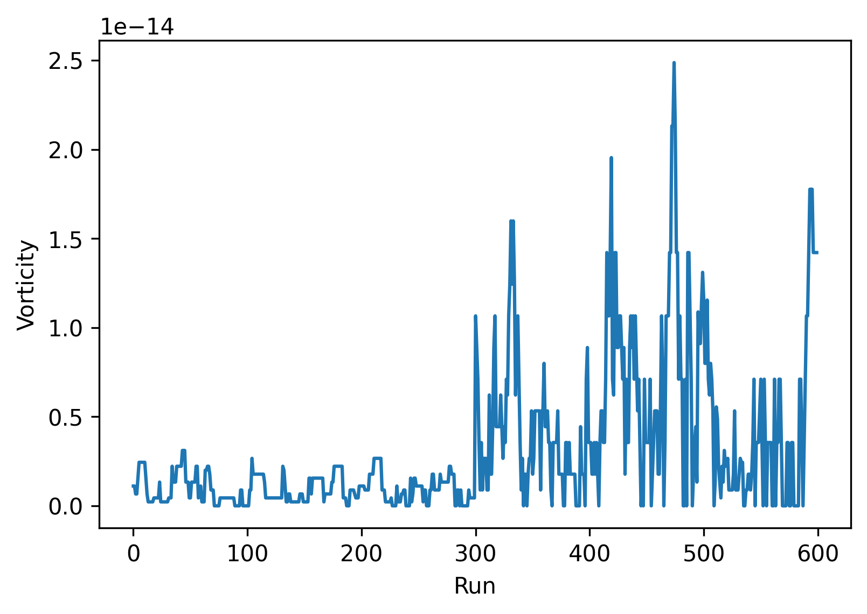
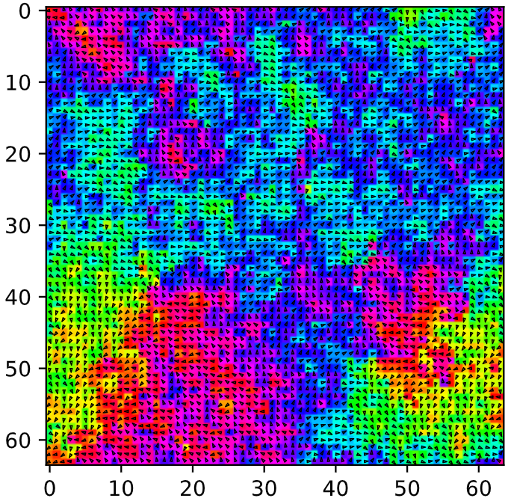
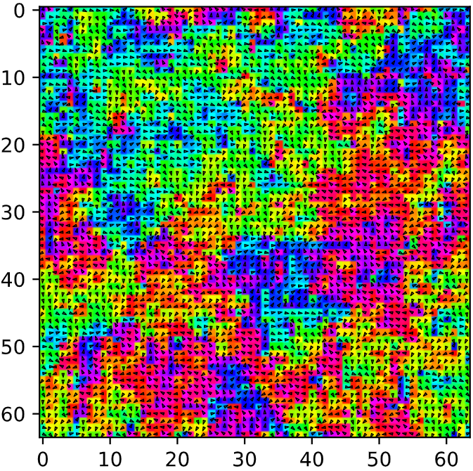
Vortices and anti-vortices
T=0.8T_{c}
T=1.2T_{c}
Low temperature phase: Pairs of vortices
High temperature phase: Unbinded vortices
Vorticity can be used as an order parameter in the XY model?
No! Problem with our code.
L=64, τ_{relax} = 600000, τ_{extra} = 2000
Notes:
However, recall that the XY model has continuous symmetry, and that such a symmetry does not break spontaneously in 2D at finite temperature. And it turns out that magnetisation, unlike in Ising model, is actually not a good order parameter to characterise the transition. (We will show this with simulation results later).
It also turns out that Kosterlitz and Thouless have shown that the phase transition in the XY model is driven by the binding and unbinding of vortex - anti-vortex pairs. So what are these vortices and anti vortices?
In the figure here, we have a vortex. The solid circle represents a spin and if the spin does a full clockwise turn, it is said to have a vorticity of +1.
In this other figure, we have the anti-vortex, where the spin does a full anti-clockwise turn, and it is said that it has a vorticity of -1.
Note that these vorticity is always of integer value. Keep this in mind because this is important.
They can be thought of as quasi-particles and Kosterlitz and Thouless showed how the emergence them led to superconductivity in thin materials. Therefore, it is of interest to study the 2D XY model.

Slide 11
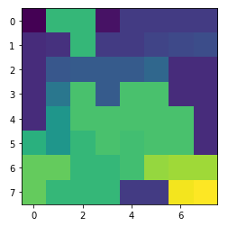
Cluster algorithm: Swendsen-Wang algorithm
Procedure:
Create clusters of similarly aligned spins with probability:
Flip all clusters with ½ probability.
[[ 1, 20, 20, 2, 19, 19, 19, 19],
[21, 3, 20, 19, 19, 4, 5, 6],
[21, 7, 18, 18, 18, 8, 21, 21],
[21, 9, 22, 18, 22, 22, 21, 21],
[21, 14, 22, 22, 22, 22, 22, 21],
[10, 14, 20, 22, 15, 22, 22, 21],
[17, 17, 20, 20, 15, 11, 16, 16],
[17, 20, 20, 20, 19, 19, 12, 13]]
Cluster formation: Each color represents a different cluster made of similarly aligned spins

Slide 12
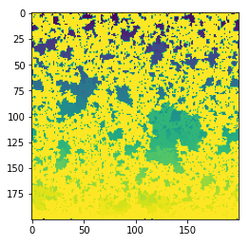
Cluster algorithm: Swendsen-Wang algorithm
Cluster algorithm: Invaded cluster (not implemented)
Procedure:
Create clusters of similarly aligned spins with probability:
Flip all clusters with ½ probability.
Obtain the critical temperature of the system with no a-priori information by inducing percolation in the spin clusters.

Slide 13
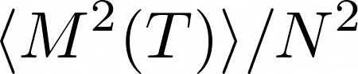
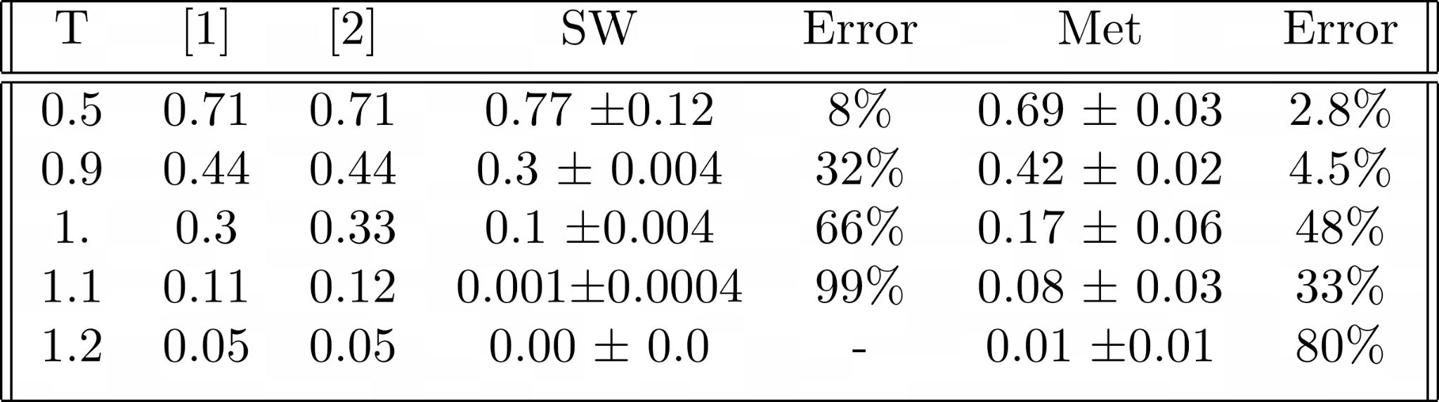
Simulation validation
[1]: https://doi.org/10.1143/PTP.60.1669 Miyashita et al 1978
[2]: https://doi.org/10.1088/0953-8984/4/24/011 Ota et al 1992
MT: τ_{relax} = τ_{wait} = 5 E5. SW: τ_{relax} = τ_{wait} = 10. Size: L =64. Error calculation: data blockage method.

Slide 14
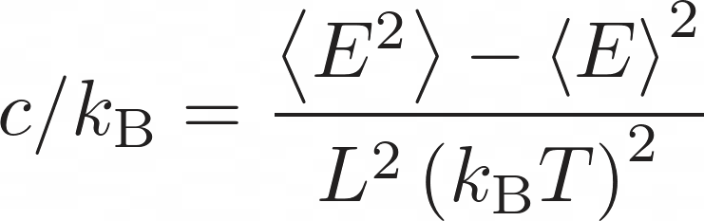
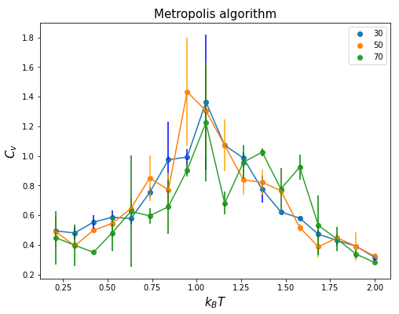
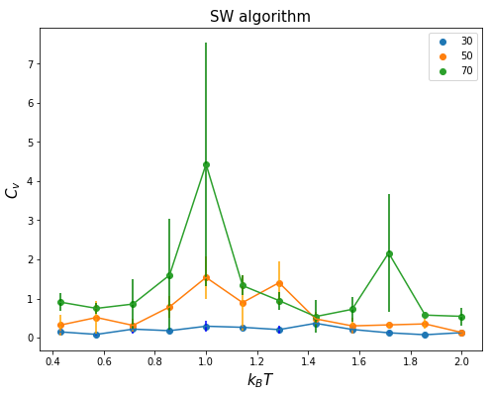
Specific heat vs Temperature
MT: t_relax = t_wait = 5 E5. SW: t_relax = 10, t_wait = 8. Error calculation: data blockage method.
Notes:
\begin{tabular}{||c c c c c c c||}
\hline
T & [1] & [2] & SW & Error & Met & Error \\ [0.5ex]
\hline\hline
0.5 & 0.71 & 0.71 & 0.77 $\pm$0.12 & 8\%& 0.69 $\pm$ 0.03 & 2.8\% \\
0.9 & 0.44 & 0.44 & 0.3 $\pm$ 0.004 & 32\% & 0.42 $\pm$ 0.02 & 4.5\% \\
1. & 0.3 & 0.33 & 0.1 $\pm$0.004 & 66\% & 0.17 $\pm$ 0.06 &48\%\\
1.1 & 0.11 & 0.12 & 0.001$\pm$0.0004 & 99\% & 0.08 $\pm$ 0.03&33\%\\
1.2 & 0.05 & 0.05 & 0.00 $\pm$ 0.0 & - & 0.01 $\pm$0.01 & 80\%\\ [1ex]
\hline
\end{tabular}

Slide 15
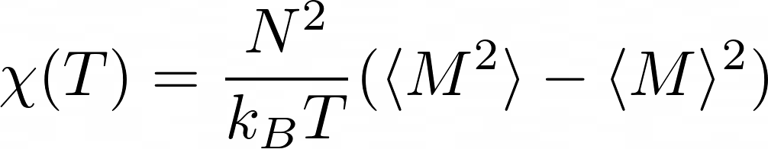
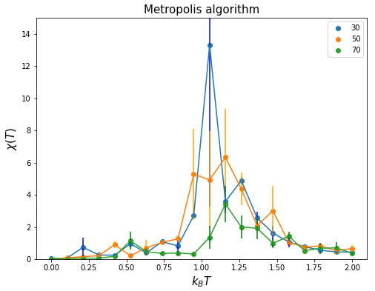
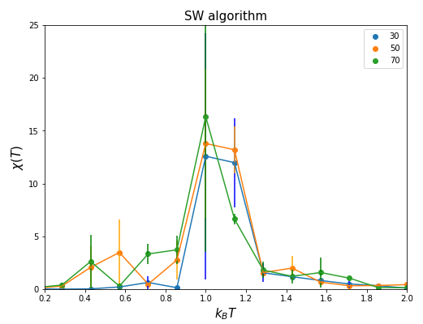
Susceptibility vs Temperature
MT: t_relax = t_wait = 5 E5. SW: t_relax = 10, t_wait = 8. Error calculation: data blockage method.

Slide 16

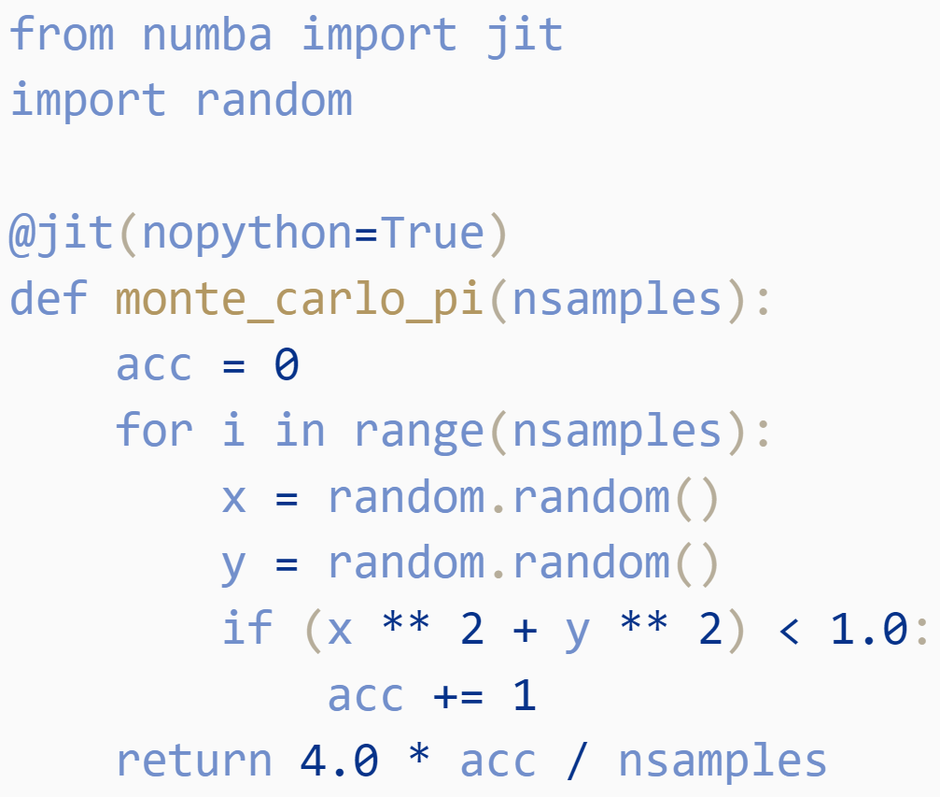
Numba
Designed to be used with NumPy
Decorator to functions
Translates to machine code
Leads to high-speed (C++)
Source: http://numba.pydata.org/

Slide 17
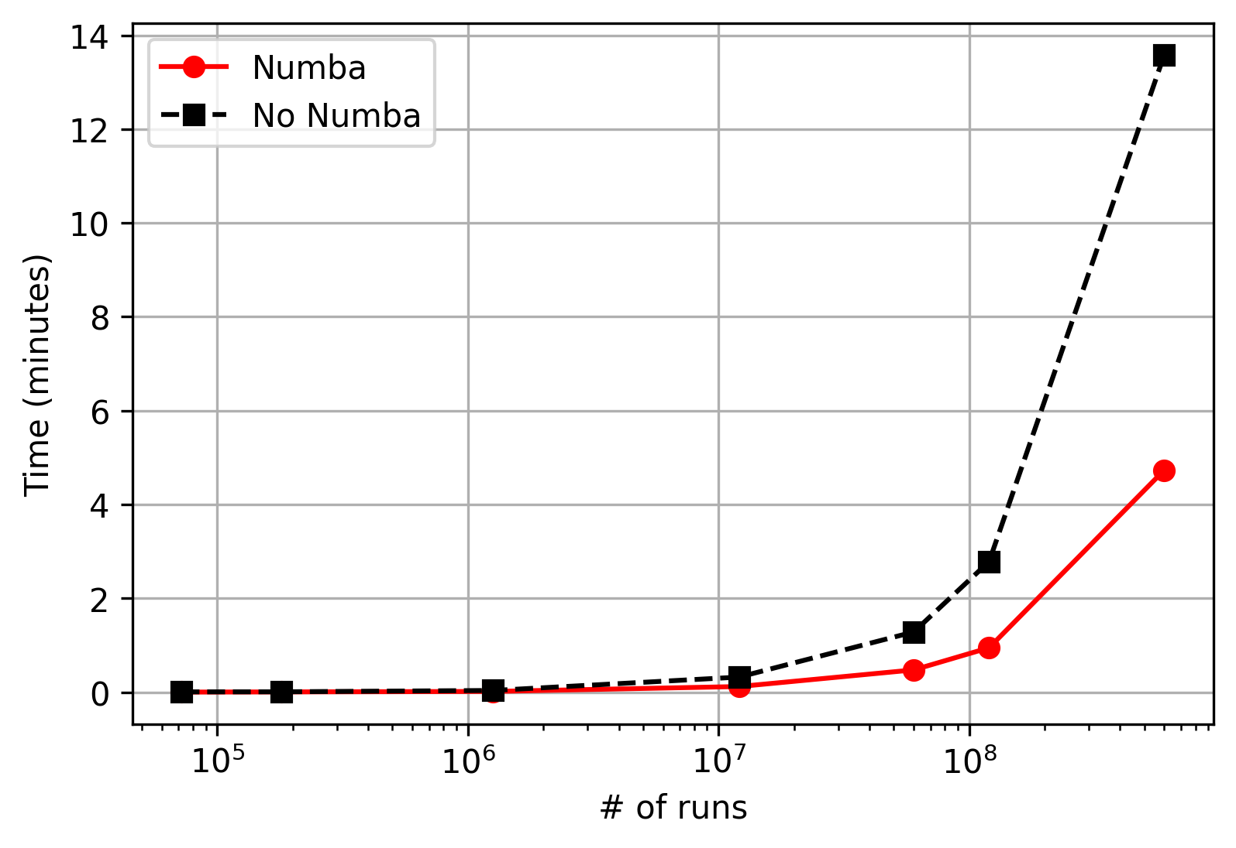
Performance: Numba vs no Numba
Small # of runs
No difference
Large # of runs
Large difference

Slide 18
Conclusion: Research questions
What is the order parameter that describes the system?
The vorticity describes the topological phase transition of the system, however we did not manage to implement it.
What is the behaviour of the system under different algorithms?
Our simulation results are in agreement with the literature. Errors are larger as temperature increase.

Slide 19
Thank you for your attention!
Questions?

Slide 20

Appendix: Slow quench
Notes:
So where is the phase transition? In the following sections we will use the Metropolis algorithm.
Let us begin with a lattice of random spins and slowly lower the temperature past the critical point.
The colourful plot shows the phase and the orange plot shows the corresponding energy of the spins due to spin-spin interaction.
As you can see it seems that the system eases into the ground state rather continuously and seemingly there isn’t a transition at all.

Slide 21
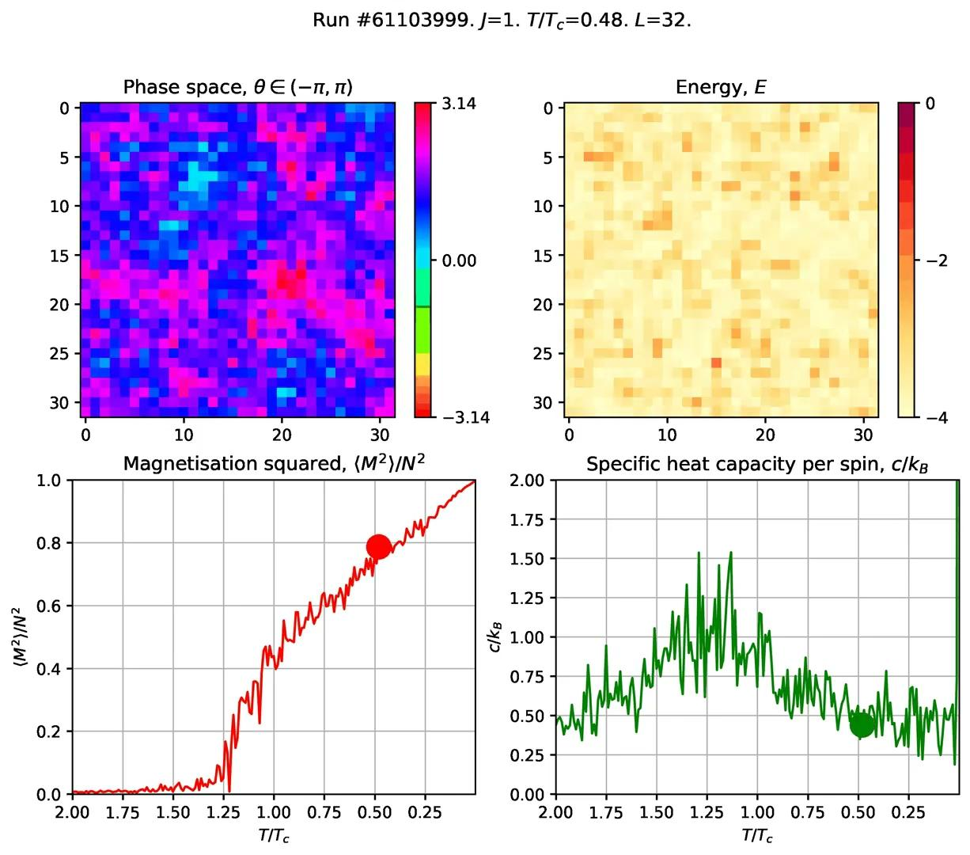
Appendix: Slow quench
Magnetisation
Sharp change at T/T_{c}=1.
Specific heat capacity
KT theory - T_{c}< peak
Notes:
Now, let us run the same experiment with the observables side by side. In the magnetisation denoted by the red curve. There is clearly a sharp drop at the critical temperature at 1.
Furthermore, the KT theory predicts that the critical temperature is lower than the peak in the specific heat capacity.
How can this be? Why is there a sharp peak? This is the same question that the Nobel laurettes attempted to answer.

Slide 22
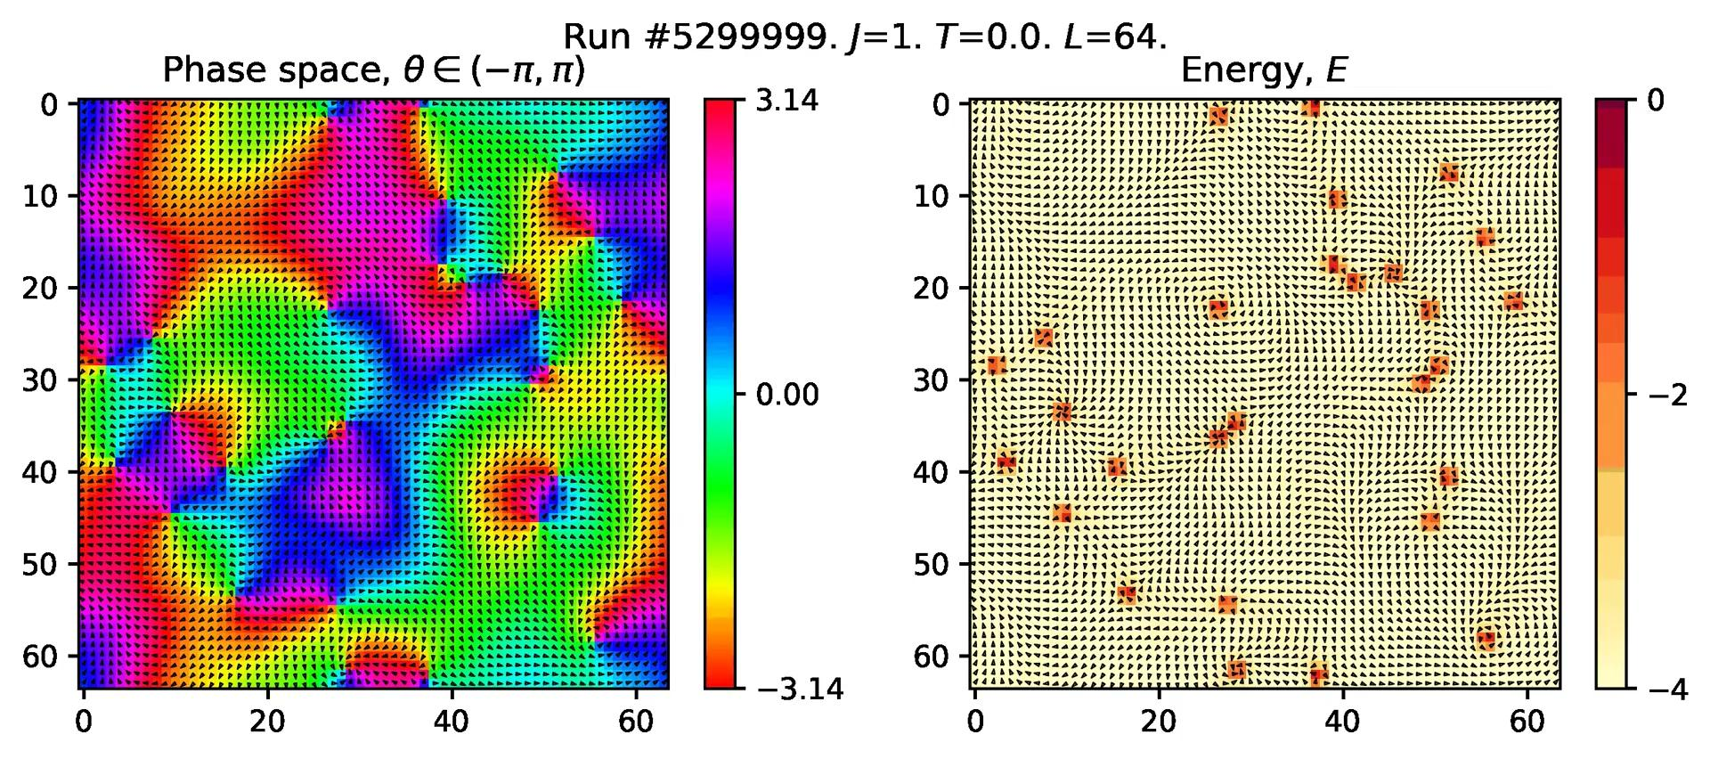
Appendix: Fast quench
Notes:
And it turns out that that can be explained by the vortices and anti-vortices pairs that arises if you perform a quench.
You can now clearly see vortice and anti-vortice pairs in this figure and they are even clearer in the energy plot.
These vortices doesn’t seem to want to fade or go away even though we are at almost 0°K. Why is that?
Recall that the vorticity of these topological particles are always an integer multiple, so there is no continuous way for them to just fade away.
Except… there is! If you see clearly, given enough time, the vortex-antivortex pairs annihilate each other and it lowers the energy of the system. Since the vortices are always formed in pairs, given enough time, they will all annihilate each other and actual ground state will be achieved.

Slide 23
Appendix: Metropolis algorithm (brief recap)
Choose a random spin as trial spin.
Rotate it by random amount.
Calculate ΔE = E_{trial} - E_{old}.
If ΔE≤0
Take trial spin as the new spin.
Else
If r<exp(-ΔE/T), r ∈ [0,1]
Take trial spin as the new spin.
Else
Continue without changes.
Notes:
Since the upcoming section uses the Metropolis algorithm, here is a brief review of the algorithm.

